Slide 1

Cloud Box
Group 6
Haohan (Harry) Xu
Ignacio Perez
Jitin Jacob
Sashiraj Dhanrajan

Slide 2

Purpose
Cloud Box
Provide an efficient and reliable storage service
Files can be accessed from different locations
Easy to share files between user’s
User friendly interface

Slide 3
Non Functional Requirements
Cloud Box
Usability
Simple interface to perform functionalities
Security
User authentication
Supportability
Runs in all platforms
Performance
Minimal response time
Scalability
Increase the number of servers

Slide 4
General Overview
Cloud Box
Total 6 distributed Servers
2 Backup Servers & 4 Service Servers
Service Servers contain an independent portion of system’s data
Backup Servers contain a copy of all system’s data
Client connect to the most appropriate service server

Slide 5
System Architecture
Cloud Box
Client Server model
3 tier architecture
User Interface (Client)
Application Logic (Client Daemon)
Application Logic (Server)
Data Storage (Server)

Slide 6
Synchronization
Cloud Box
Client- Server synchronization is achieved by using the Routing Table which is present in all the servers.
Routing Tables will have the information regarding location of files in each server and file owner’s username, all Routing Tables will have consistent entries.
Similarly for Server-Backup Server, the files are synchronized on the fly.
One service server will synchronize data with backup servers, and routing table entries with all other servers.
Clients are synchronized with the server by a click of a button at client side.

Slide 7
Consistency
Cloud Box
A file is stored in one Service Server and in both Backup Servers
Every file has a version number. Only the latest version is stored in the system
When a new node is added as a server, the node will ask for routing table from other servers.

Slide 8
Cloud Box
Once a file is modified, changes are replicated to both additional storage locations
Consistency between service server and backup servers when file version changed

Slide 9
Cloud Box
Before a server starts receiving connections, updates its files with latest version
Data recovery of server failure

Slide 10
Communication
Cloud Box
Sockets are used for communication between nodes.
Multithreading in server and single thread in client.
Client communicates with one server when accesses the same file.
One service server communicate with all other servers for message passing while only transfer data to backup servers.
Request message and data transfer between client and server

Slide 11
Optimization
Cloud Box
Data partition & incremental backup:
Divide file into fixed size of chunks
Instead of synchronize whole file, only synchronize modified chunks of data of that file
Better server selection algorithm
Select service server to provide service according to both responding time and current work load of server.

Slide 12
Tools
Cloud Box
Project Management
MS Project
MS Visio
MS Office
Development
Eclipse for Java/JAVAFX
MS Azure
Blob for data storage
VM runs server side application
GitHub/Git

Slide 13
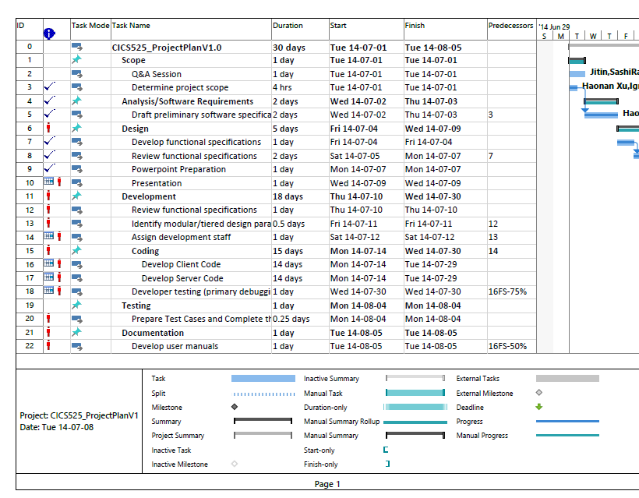
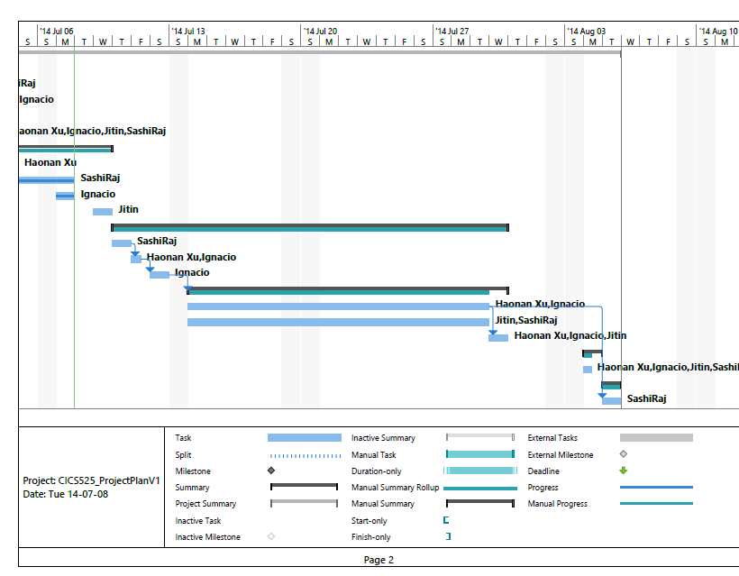
Project Management
Cloud Box
Gantt Chart

Slide 14
Project Management
Cloud Box
Resource Stats
Name | Start | Finish | Remaining Work
 | NA | NA | 0 hrs
 | NA | NA | 0 hrs
Ignacio | Tue 14-07-01 | Mon 14-08-04 | 288.63 hrs
Haonan Xu | Tue 14-07-01 | Mon 14-08-04 | 265.63 hrs
 | NA | NA | 0 hrs
 | NA | NA | 0 hrs
 | NA | NA | 0 hrs
 | NA | NA | 0 hrs
 | NA | NA | 0 hrs
SashiRaj | Tue 14-07-01 | Tue 14-08-05 | 276.63 hrs
Jitin | Tue 14-07-01 | Mon 14-08-04 | 292.63 hrs

Slide 15
Demo

Slide 16
Questions?

